Slide 1
Decision Making in the Face of Deeply Uncertain Threshold Responses
Jan Kwakkel, Caitlin Spence, and Klaus Keller

Slide 2
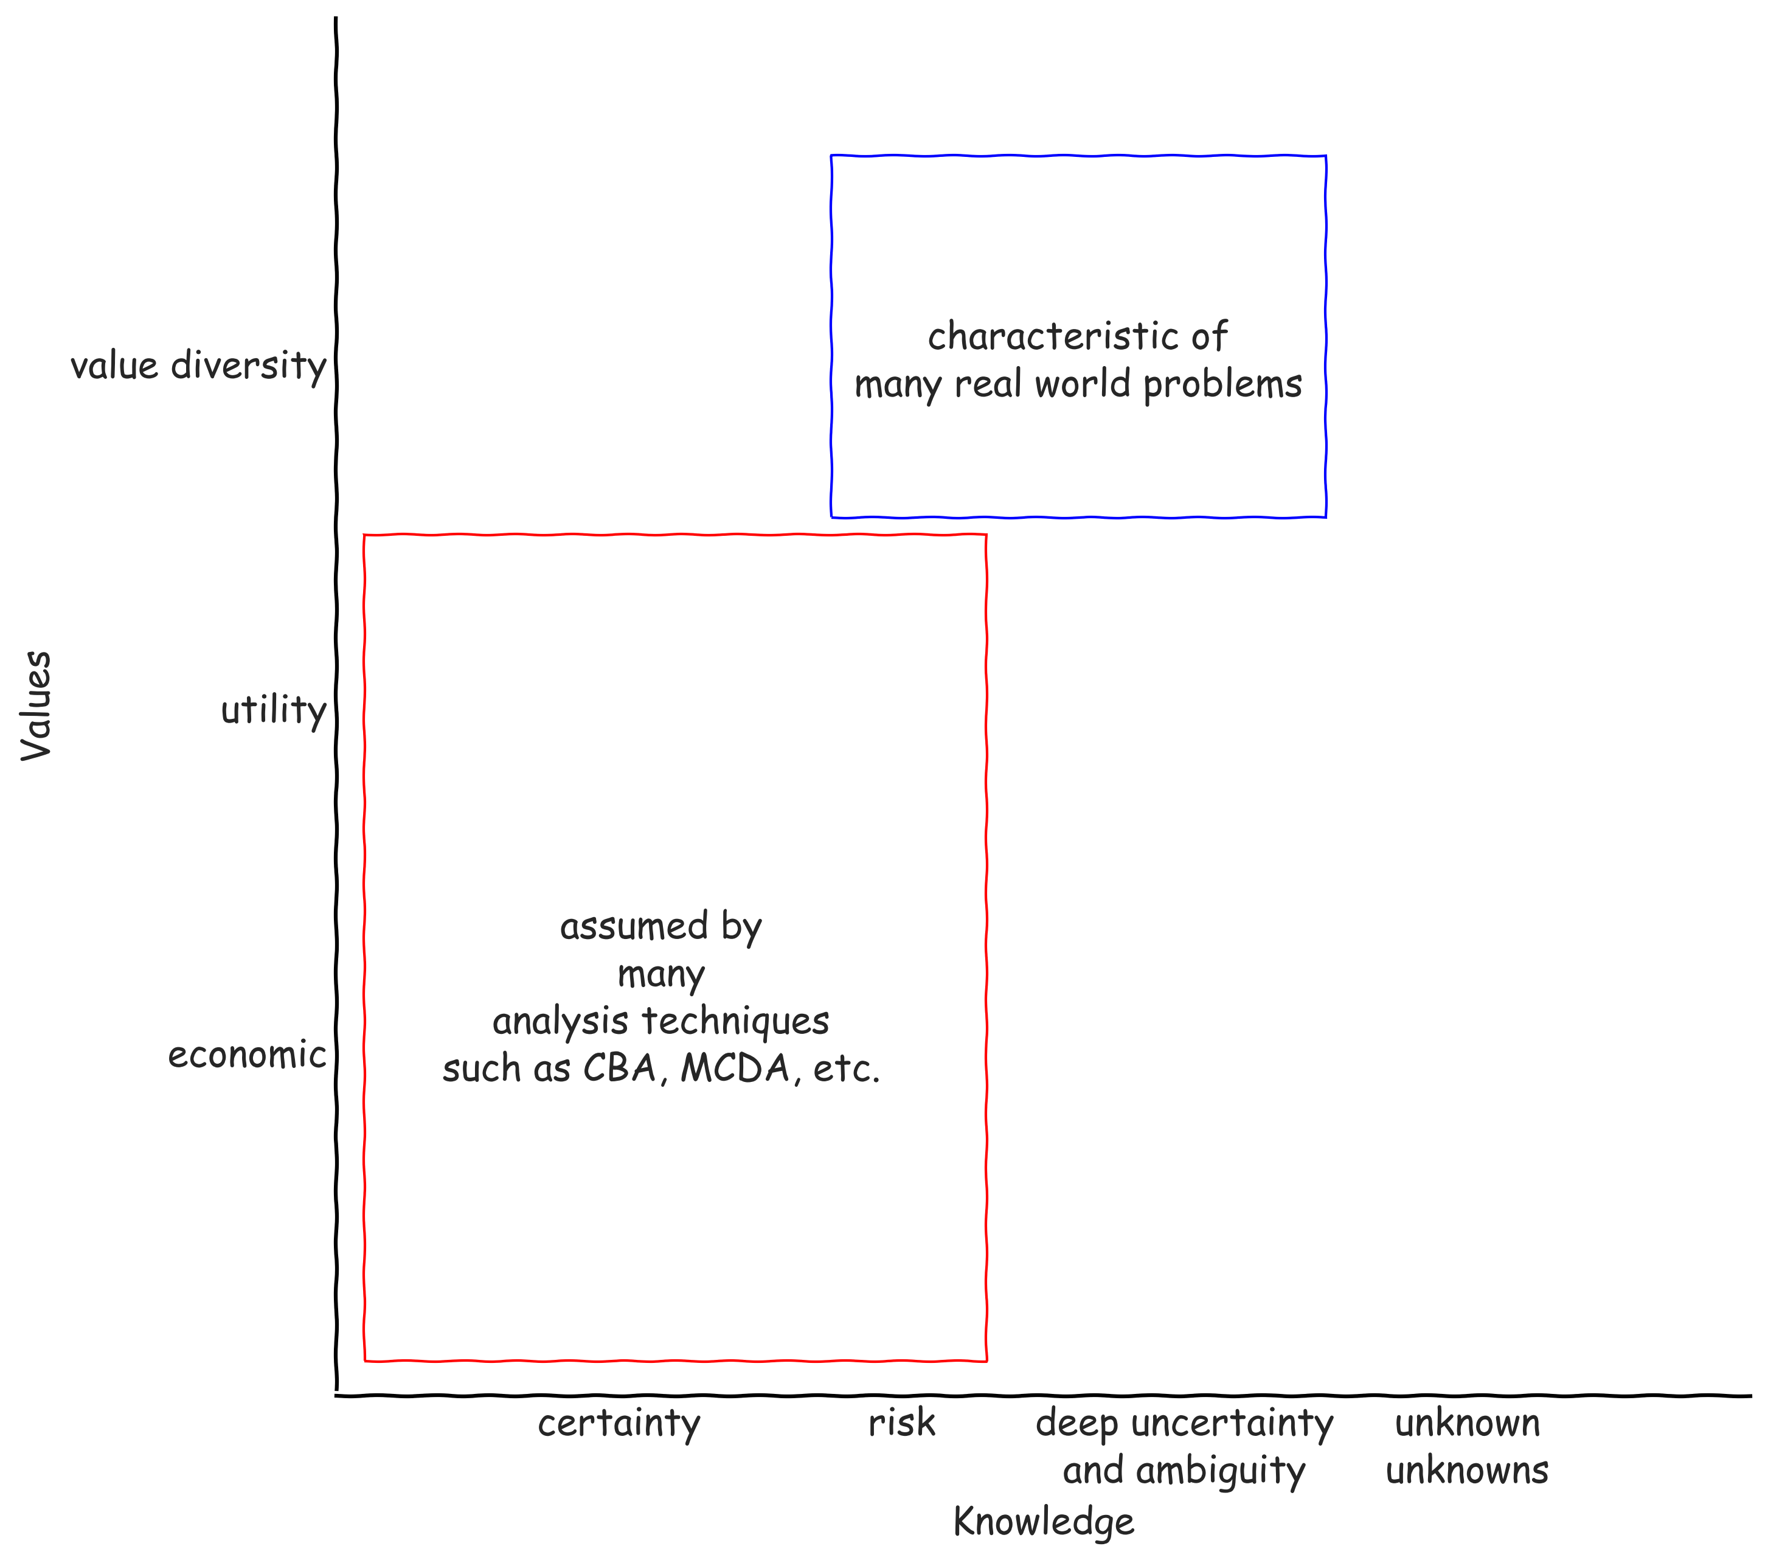

Slide 3
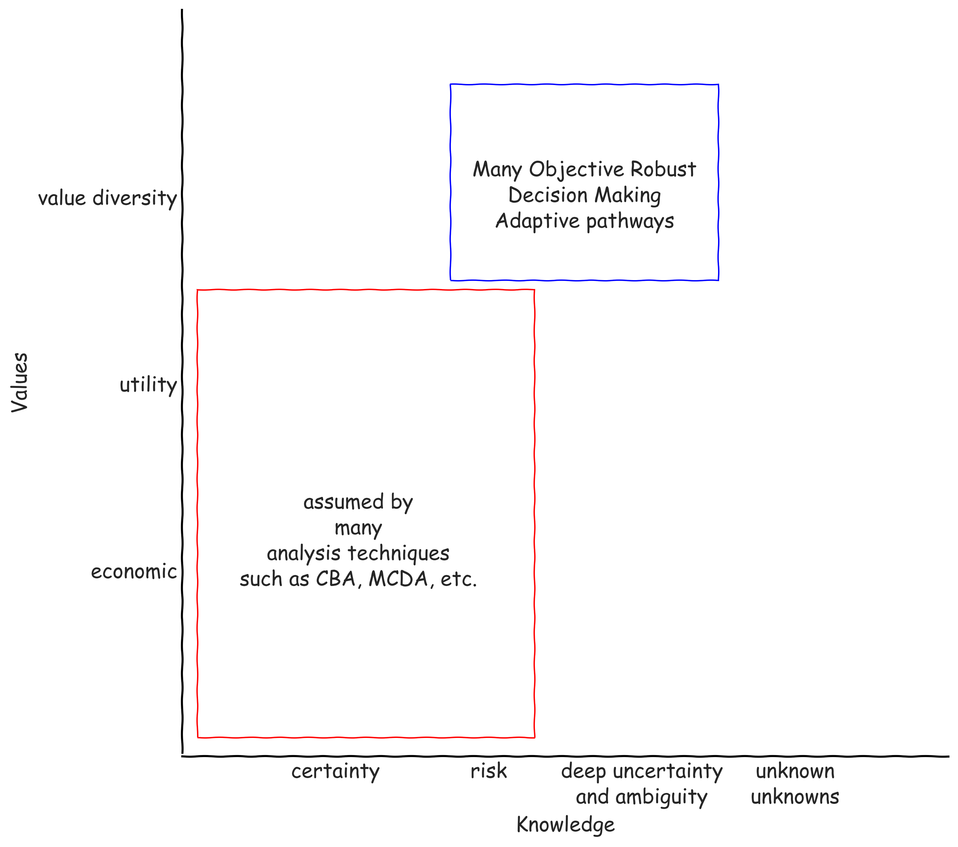

Slide 4
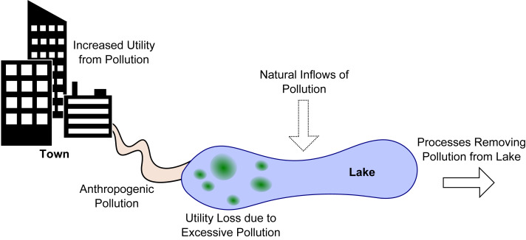
Lake Problem
Adapted from Hadka et al (2015) doi: 10.1016/j.envsoft.2015.07.014

Slide 5


Slide 6
Endogenous learning
Quinn et al (2017) doi 10.1016/j.envsoft.2017.02.017

Slide 7
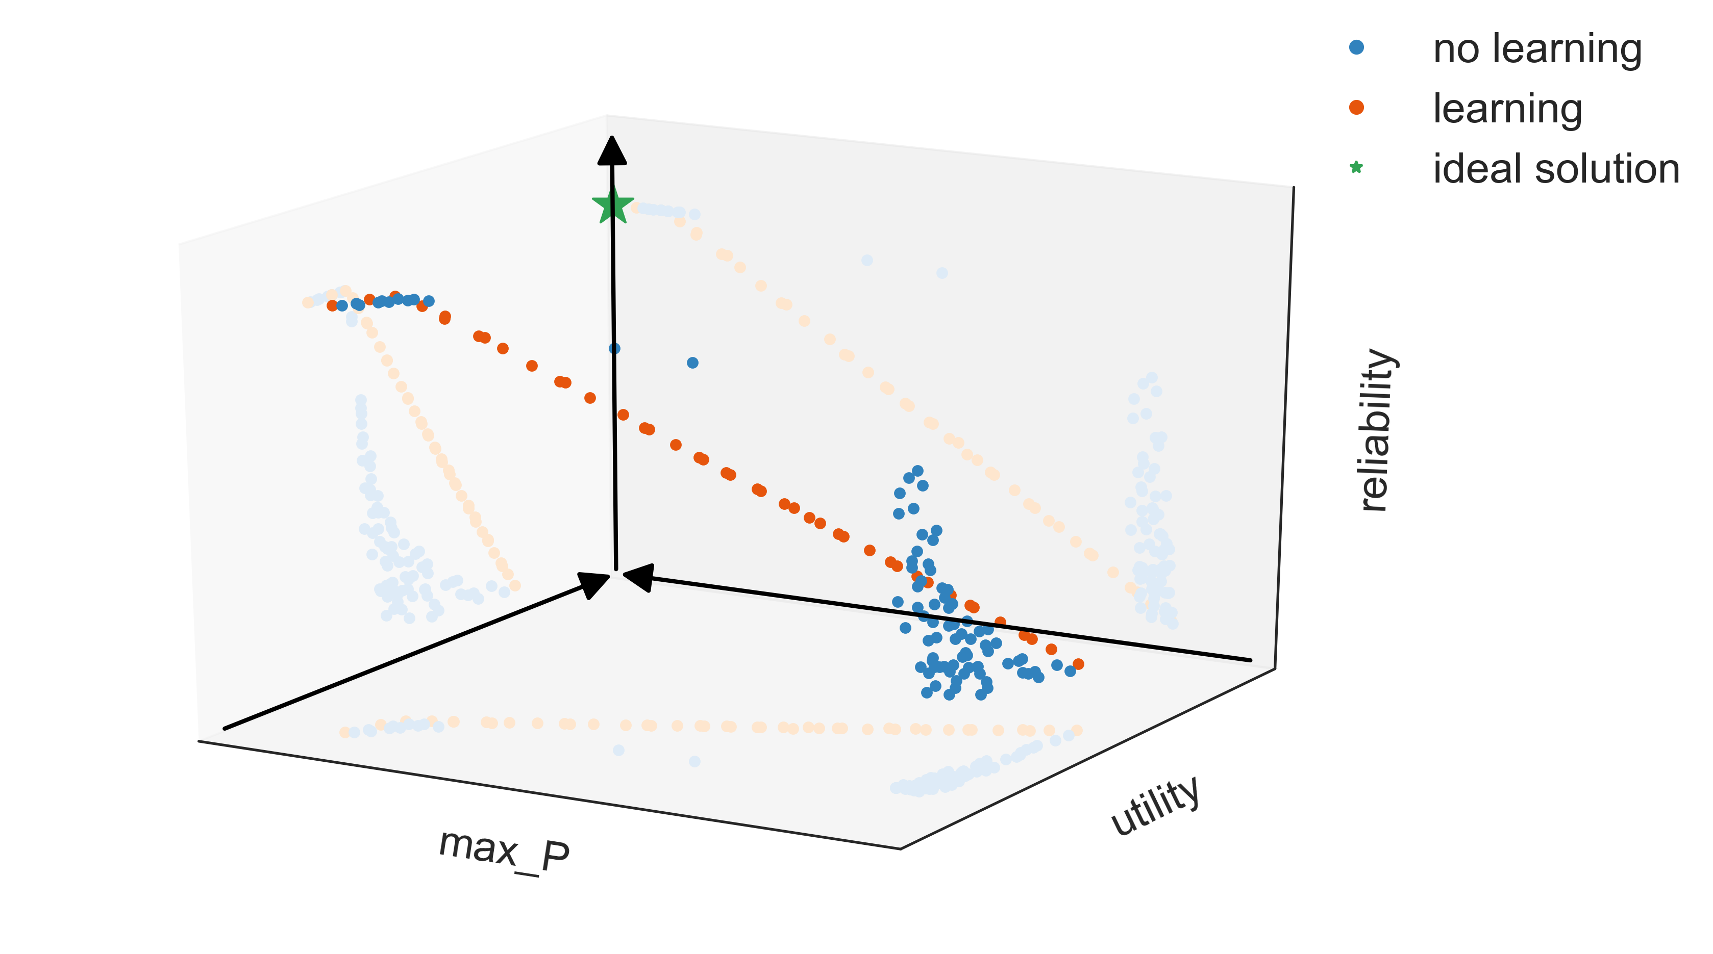

Slide 8
Deep Uncertainty
Do we know the correct parameterization for the natural inflow?
Do we know this exactly?
How to discount this over time?

Slide 9
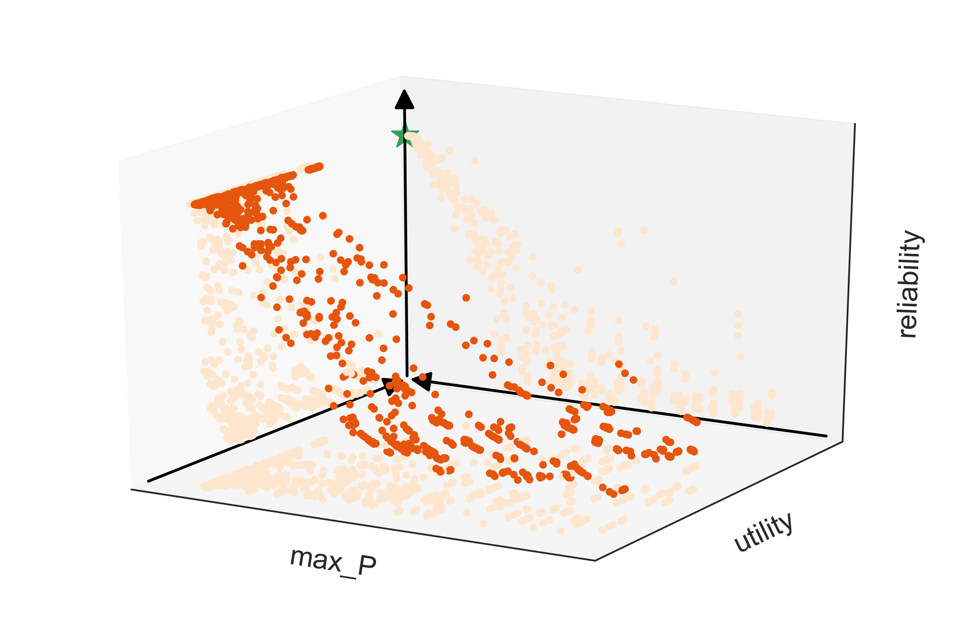
Deep Uncertainty re-evaluation
Notes:
Performance of learning solutions with a reliability > 0.6 in the reference case over 1000 samples across the various deep uncertainties

Slide 10
How to address deep uncertainty
Search for several carefully selected scenarios
Robust optimization
(Iterative refinement using scenario discovery)

